Slide 1
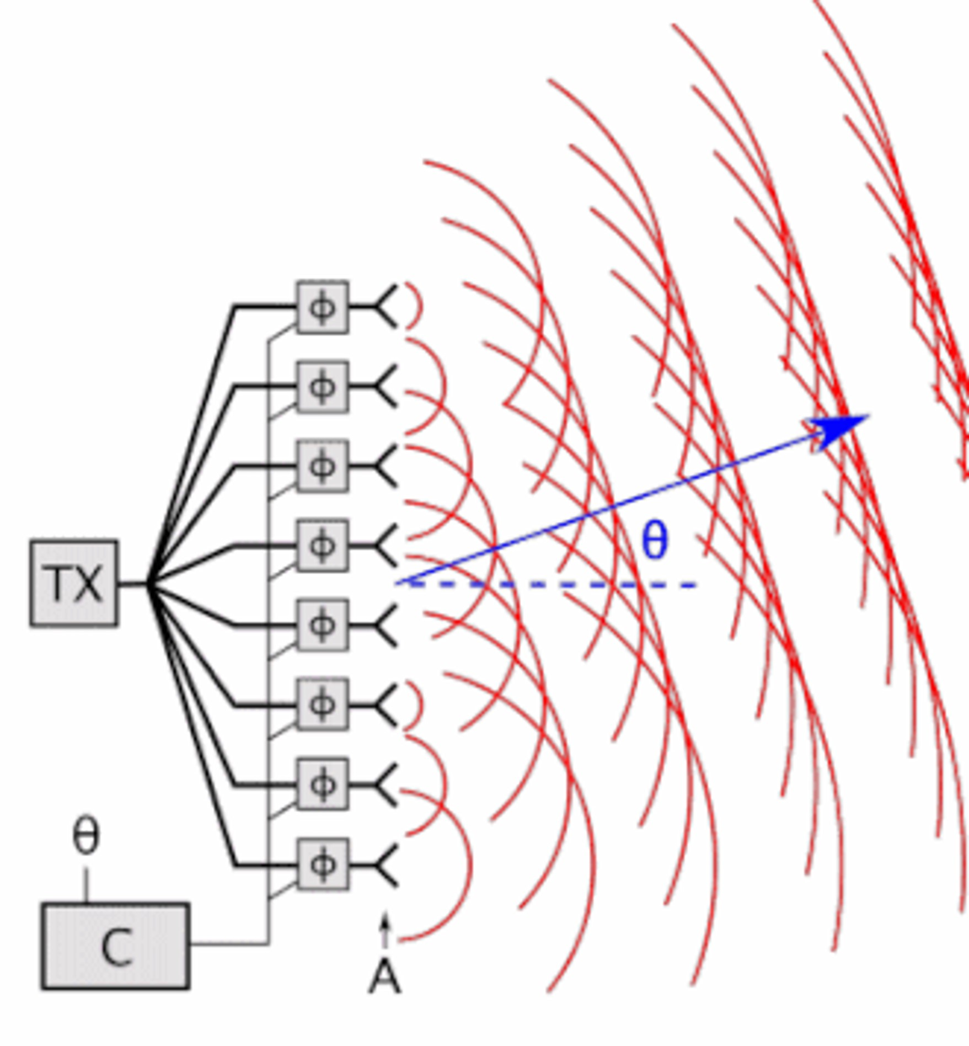

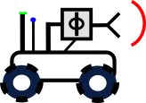

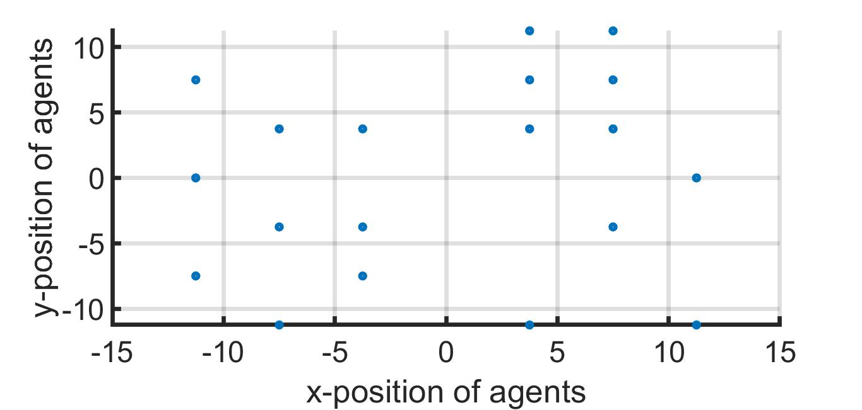
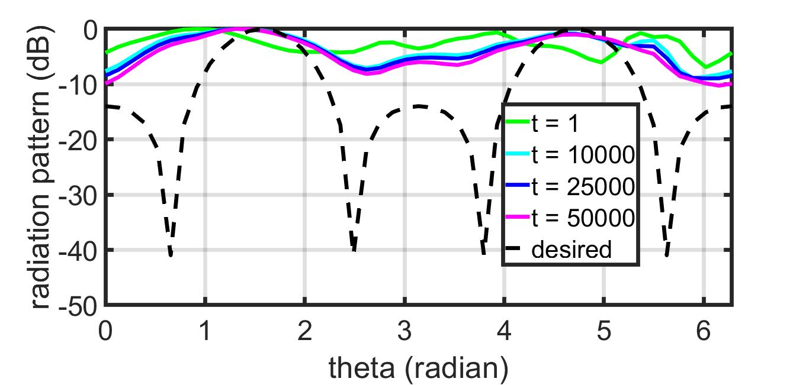
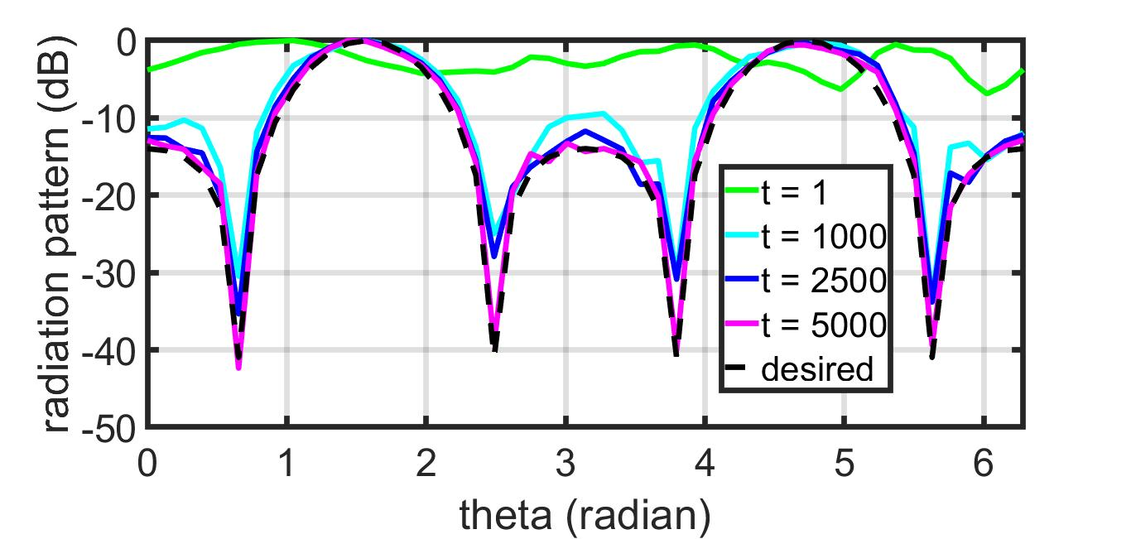
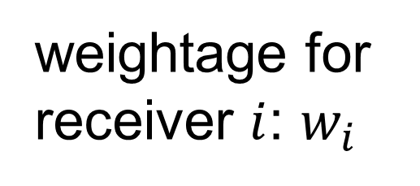
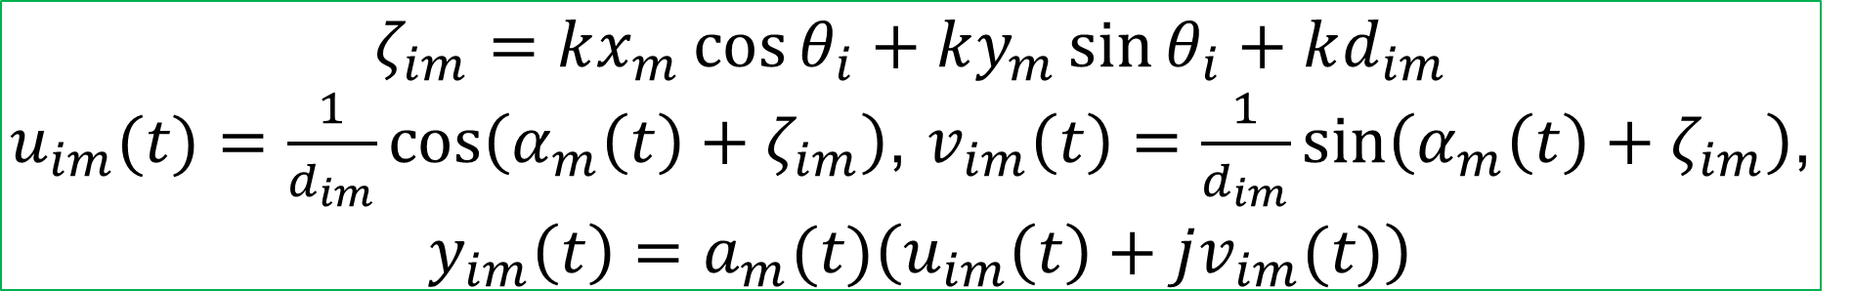
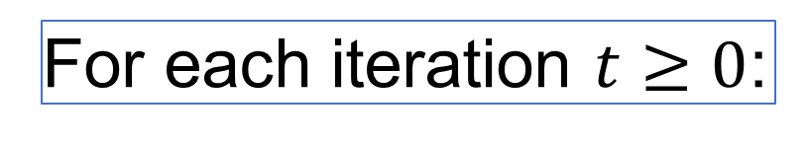
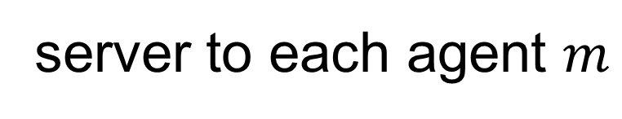
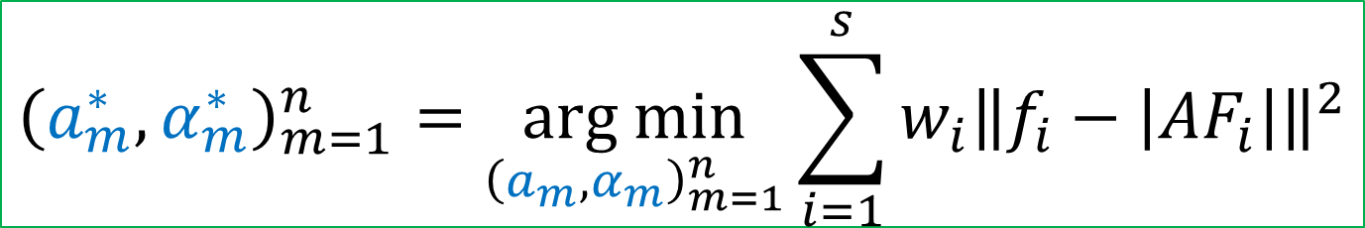
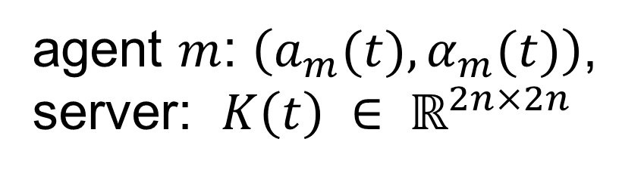
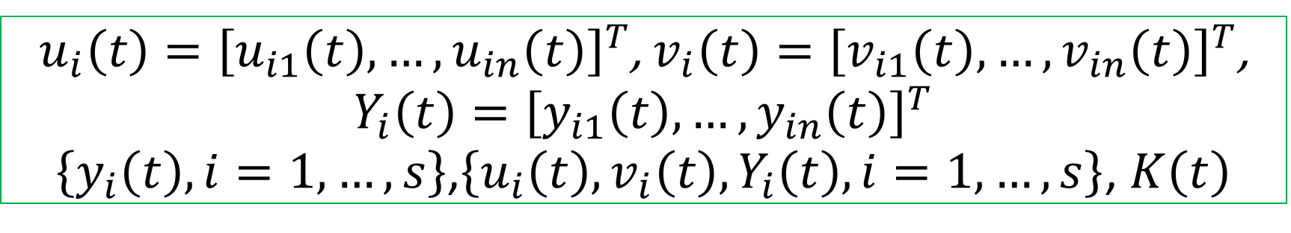
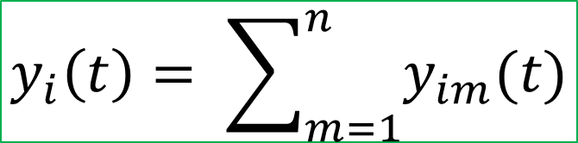



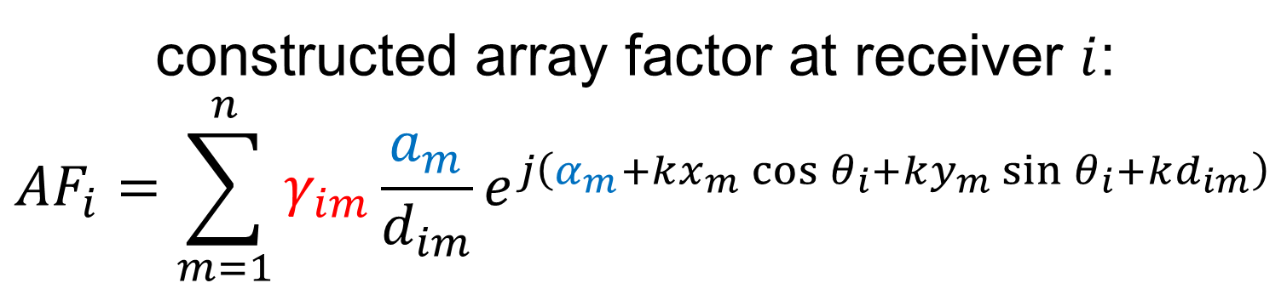
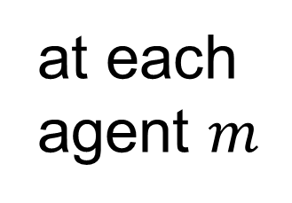
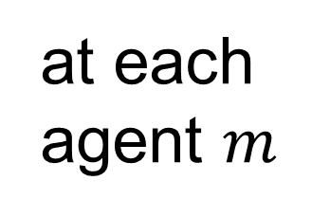


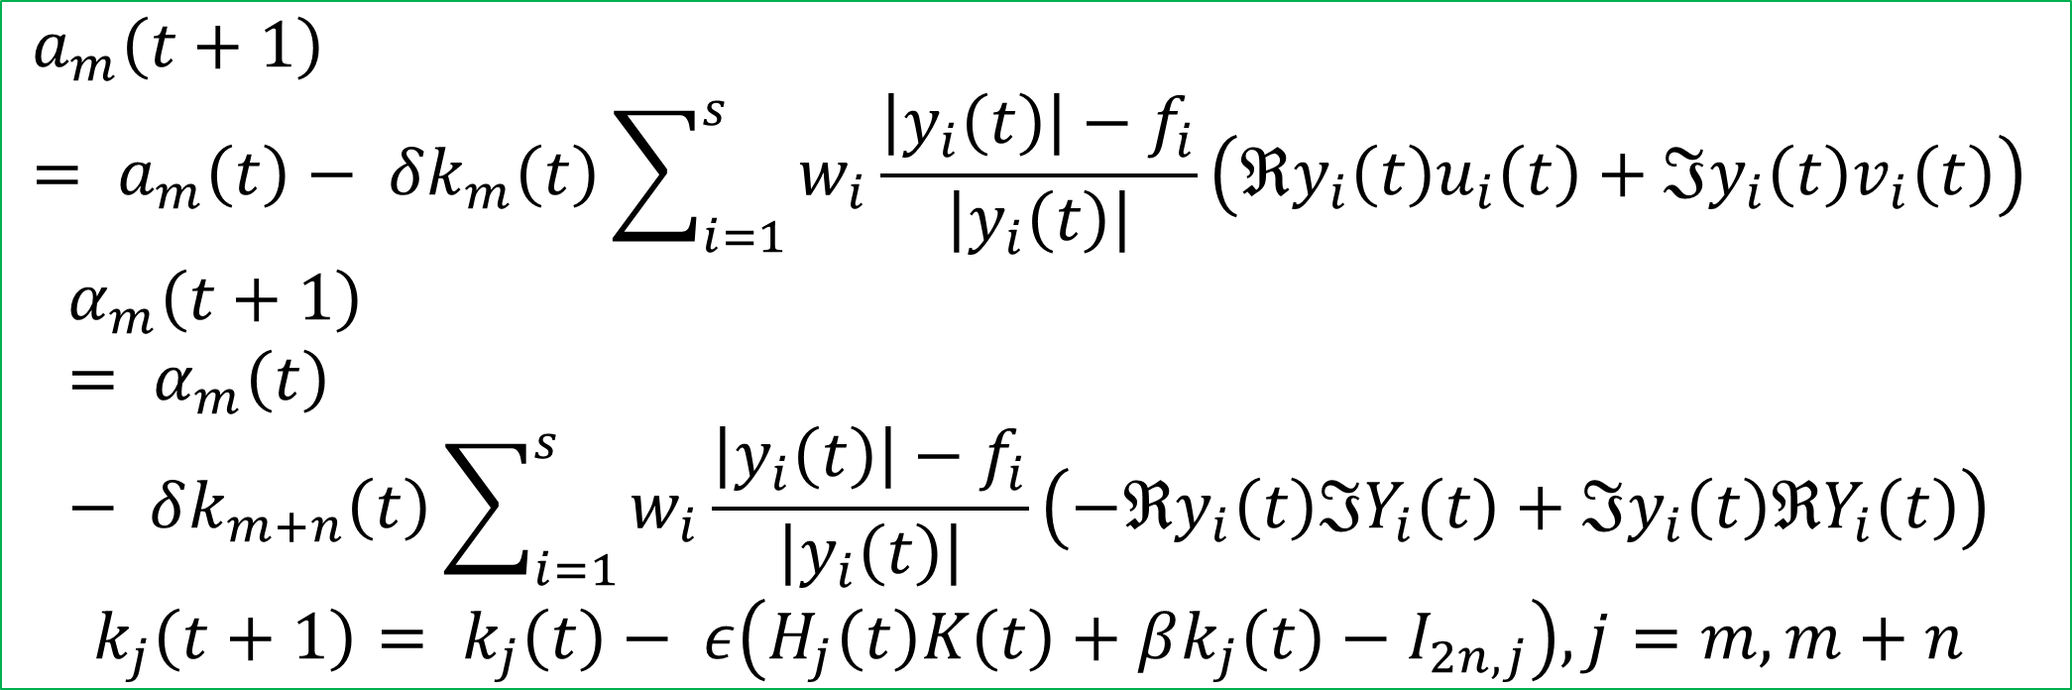
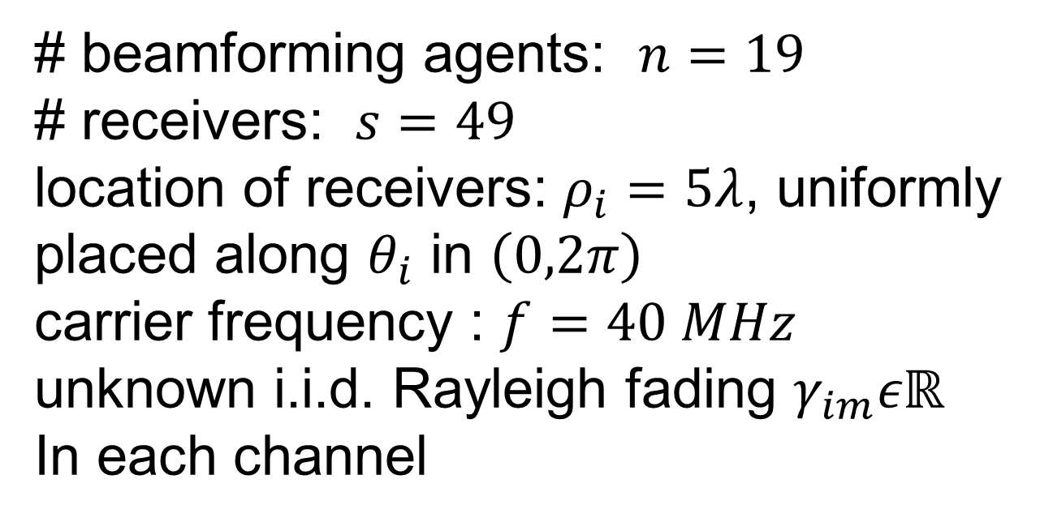

2022 Asilomar Conference on Signals, Systems, and Computers
Fast Distributed Beamforming without Receiver Feedback
Kushal Chakrabarti (UMD), Amrit S. Bedi (UMD), Fikadu T. Dagefu (ARL), Jeffrey N. Twigg (ARL), Nikhil Chopra (UMD)
Paper # 1423
Introduction
Problem Formulation
Comparison with Related Works
Objective: autonomous multi-robots collaboratively form an antenna array to transmit a high-power directed signal while steering nulls though precise control of interference
Strategy: accelerated matching of a given far-field radiation pattern in uncertain communication environments
Army Capability: increased command post maneuverability while maintaining covert operations through sophisticated signature management strategies
beamforming agents: $m=1,…,n$
receivers: $i=1,…,s$
location of agent $m$: $\left(x_{m},y_{m}\right)$
location of receiver $i$: $\left(ρ_{i},θ_{i}\right)$
desired array factor amplitude at receiver $i$: $f_{i}$
distance between agent $m$ and receiver $i$:
$$d_{im}=\sqrt{{\left(x_{m}−ρ_{i}cos{θ_{i}}\right)}^{2}+{\left(y_{m}−ρ_{i}sin{θ_{i}}\right)}^{2}}$$
excitation signal amplitude and phase of agent $m$: $\left(a_{m},α_{m}\right)$
synchronized carrier frequency : $f$
wavenumber: $k=\frac{2πf}{3×{10}^{8}}$ 1/m
Prior Work | Our Work
objective: maximizing gain or steering nulls at specific locations | objective: beampattern matching advantages: precise control over desired power at multiple locations, inherent simultaneous beamforming and nullforming in constructive manner, can include additional constraints (limited transmit power, derivative constraints when receiver locations are not precisely known)
utilize receiver feedbacks | does not require receiver feedbacks
sparse beamforming, mobile agents | fixed number of agents, stationary agents
channel model-free, probabilistic channel prediction and path planning for minimizing power | feedback-free objective of beampattern matching
receiver feedback-free | does not assume line-of-sight channels
Coherent
Phase Front
Null Rx
Distributed
Across
Robots
constructed array factor at receiver $i$:
$${AF}_{i}=\sum_{m=1}^{n}{γ_{im}\frac{a_{m}}{d_{im}}e^{j\left(α_{m}+kx_{m}\cos{θ_{i}}+ky_{m}\sin{θ_{i}+kd_{im}}\right)}}$$
control parameters
weightage for receiver $i$: $w_{i}$
unknown multipath fading
$${\left(a_{m}^{∗},α_{m}^{∗}\right)}_{m=1}^{n}=\underset{{\left(a_{m},α_{m}\right)}_{m=1}^{n}}{arg min}{\sum_{i=1}^{s}{w_{i}{\left\|f_{i}−\left|{AF}_{i}\right|\right\|}^{2}}}$$
Proposed Algorithm: IPG-DB
proposed a novel algorithm: Iteratively Pre-conditioned Gradient-descent for Distributed Beamforming (IPG-DB)
significantly faster than the gradient-descent (GD) based methods
can be incorporated in alternate optimization framework for joint optimization of position, sparsity, and excitation: replace slower GD with faster IPG-DB
does not rely on receiver feedbacks
does not assume channel fading parameters: robust to noise
Phase Controller
Target Rx
agent $m$: $\left(a_{m}(t),α_{m}(t)\right)$, server: $K\left(t\right) ∈ ℝ^{2n×2n}$
before iterations, server broadcasts to each agent: $ε, β, δ, K(0)$
For each iteration $t≥0$:
$$ζ_{im}=kx_{m}\cos{θ_{i}}+ky_{m}\sin{θ_{i}+kd_{im}}$$
$u_{im}(t)=\frac{1}{d_{im}}\cos\left(α_{m}\left(t\right)+ζ_{im}\right)$, $v_{im}\left(t\right)=\frac{1}{d_{im}}\sin\left(α_{m}\left(t\right)+ζ_{im}\right)$,
$y_{im}\left(t\right)=a_{m}(t)\left(u_{im}\left(t\right)+jv_{im}(t)\right)$
Proposed Settings of Beamforming Agents
at each agent $m$
Simulation Results: Synthetic Data
server
$\left\{u_{im}\left(t\right),v_{im}\left(t\right),y_{im}\left(t\right), i=1,…,s\right\}$, $k_{m}\left(t\right),k_{m+n}\left(t\right)$
# beamforming agents: $n=19$
# receivers: $s=49$
location of receivers: $ρ_{i}=5λ$, uniformly placed along $θ_{i}$ in $\left(0,2π\right)$
carrier frequency : $f=40 MHz$
unknown i.i.d. Rayleigh fading $γ_{im}εℝ$
In each channel
agent $m$ to server
Far-field Rx
at server
$$y_{i}\left(t\right)= \sum_{m=1}^{n}{y_{im}(t)}$$
Tx agents
server to each agent $m$
$$a_{1},α_{1}$$
$$a_{2},α_{2}$$
$$a_{m},α_{m}$$
$u_{i}\left(t\right)={\left[u_{i1}\left(t\right),…,u_{in}\left(t\right)\right]}^{T}$, $v_{i}\left(t\right)={\left[v_{i1}\left(t\right),…,v_{in}\left(t\right)\right]}^{T}$, $Y_{i}\left(t\right)={\left[y_{i1}\left(t\right),…,y_{in}\left(t\right)\right]}^{T}$
$\left\{y_{i}\left(t\right), i=1,…,s\right\}$,$\left\{u_{i}\left(t\right),v_{i}\left(t\right),Y_{i}\left(t\right), i=1,…,s\right\}$, $K\left(t\right)$
server-agent based setting
agents can communicate with a common server
no peer-to-peer communication
what is a server?
can be an auxiliary node, located close to the agents
can exchange information with the agents
can perform basic operations, e.g., addition, multiplication, etc.
need not know the beamforming coefficients, agents’ and receivers’ locations, desired beam and null values
at each agent $m$
$$a_{m}\left(t+1\right)= a_{m}\left(t\right)− δk_{m}\left(t\right)\sum_{i=1}^{s}{w_{i}\frac{\left|y_{i}\left(t\right)\right|−f_{i}}{\left|y_{i}\left(t\right)\right|}}\left(ℜy_{i}\left(t\right)u_{i}\left(t\right)+ℑy_{i}\left(t\right)v_{i}\left(t\right)\right)$$
$$α_{m}\left(t+1\right)= α_{m}\left(t\right)− δk_{m+n}\left(t\right)\sum_{i=1}^{s}{w_{i}\frac{\left|y_{i}\left(t\right)\right|−f_{i}}{\left|y_{i}\left(t\right)\right|}}\left(−ℜy_{i}\left(t\right)ℑY_{i}\left(t\right)+ℑy_{i}\left(t\right)ℜY_{i}\left(t\right)\right)$$
$$k_{j}\left(t+1\right)= k_{j}\left(t\right)− ε\left(H_{j}\left(t\right)K\left(t\right)+βk_{j}\left(t\right)−I_{2n,j}\right), j=m,m+n$$
GD
IPG-DB
This research is supported by U.S. Army Grant No. W911NF2120076

Slide 2

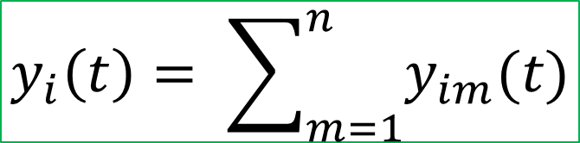
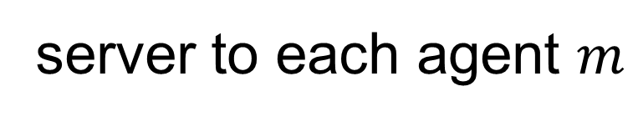



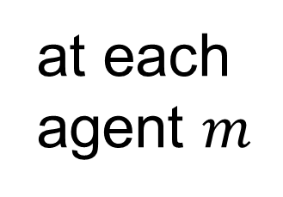
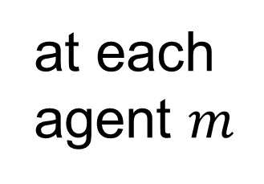

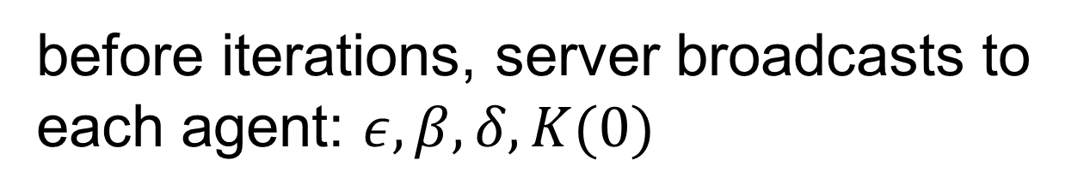
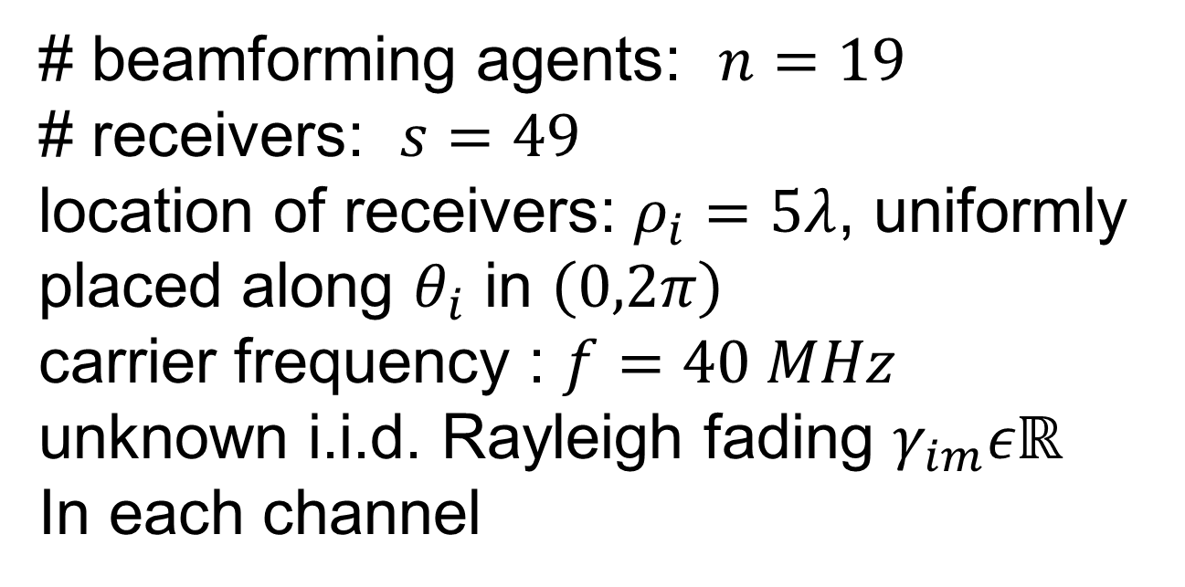




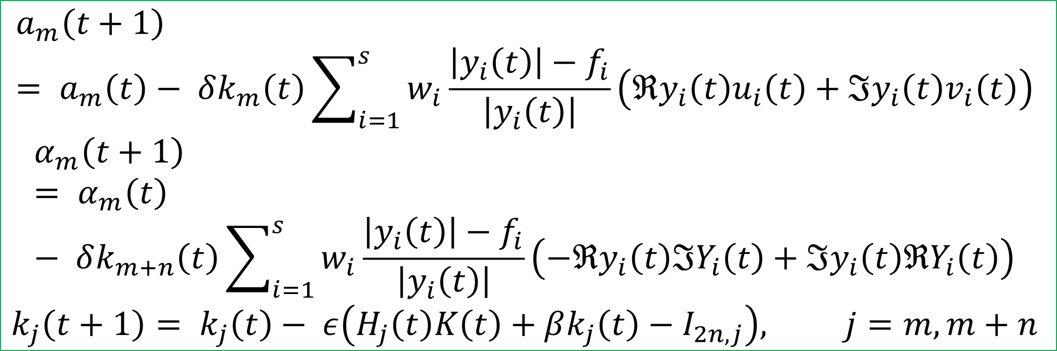
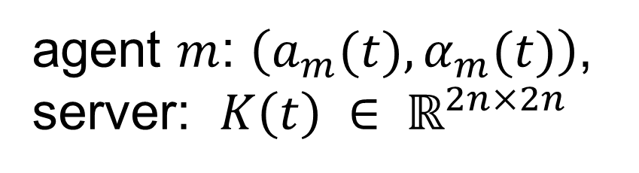


2022 Asilomar Conference on Signals, Systems, and Computers
Fast Distributed Beamforming without Receiver Feedback
Kushal Chakrabarti (UMD), Amrit S. Bedi (UMD), Fikadu T. Dagefu (ARL), Jeffrey N. Twigg (ARL), Nikhil Chopra (UMD)
Paper # 1423
Introduction
Objective: autonomous multi-robots collaboratively form an antenna array to transmit a high-power directed signal while steering nulls though precise control of interference for covert communication
Strategy: accelerated matching of a given far-field radiation pattern in uncertain communication environments
Comparison with Related Works
Problem Formulation
Prior Work | Our Work
objective: maximizing gain or steering nulls at specific locations [1] | objective: beampattern matching advantages: precise control over desired power at multiple locations, special case includes simultaneous beamforming and nullforming at specified locations, can include additional constraints (limited transmit power, derivative constraints when receiver locations are not precisely known)
utilize receiver feedbacks [2] | does not require receiver feedbacks
sparse beamforming, mobile agents [3] | fixed number of agents, stationary agents
channel model-free [2], channel prediction and path planning for minimizing power [4] | feedback-free objective of beampattern matching
receiver feedback-free [5] | does not assume line-of-sight channels
beamforming agents: $m=1,…,n$
receivers: $i=1,…,s$
location of agent $m$: $\left(x_{m},y_{m}\right)$
location of receiver $i$: $\left(ρ_{i},θ_{i}\right)$
desired array factor amplitude at receiver $i$: $f_{i}$
distance between agent $m$ and receiver $i$:
$$d_{im}=\sqrt{{\left(x_{m}−ρ_{i}cos{θ_{i}}\right)}^{2}+{\left(y_{m}−ρ_{i}sin{θ_{i}}\right)}^{2}}$$
excitation signal amplitude and phase of agent $m$: $\left(a_{m},α_{m}\right)$
synchronized carrier frequency : $f$
wavenumber: $k=\frac{2πf}{3×{10}^{8}} m^{−1}$
Coherent
Phase Front
Null Rx
Distributed
Across
Robots
constructed array factor at receiver $i$:
$${AF}_{i}=\sum_{m=1}^{n}{γ_{im}\frac{a_{m}}{d_{im}}e^{j\left(α_{m}+kx_{m}\cos{θ_{i}}+ky_{m}\sin{θ_{i}+kd_{im}}\right)}}$$
control parameters
weightage for receiver $i$: $w_{i}$
unknown multipath fading
$${\left(a_{m}^{∗},α_{m}^{∗}\right)}_{m=1}^{n}=\underset{{\left(a_{m},α_{m}\right)}_{m=1}^{n}}{arg min}{\sum_{i=1}^{s}{w_{i}{\left\|f_{i}−\left|{AF}_{i}\right|\right\|}^{2}}}$$
Phase Controller
Target Rx
Proposed Settings of Beamforming Agents
Proposed Algorithm: IPG-DB
Simulation Results: Synthetic Data
server
# beamforming agents: $n=19$
# receivers: $s=49$
location of receivers: $ρ_{i}=5λ$, uniformly placed along $θ_{i}$ in $\left(0,2π\right)$
carrier frequency : $f=40 MHz$
unknown i.i.d. Rayleigh fading $γ_{im}εℝ$
In each channel
agent $m$: $\left(a_{m}(t),α_{m}(t)\right)$, server: $K\left(t\right) ∈ ℝ^{2n×2n}$
before iterations, server broadcasts to each agent: $ε, β, δ, K(0)$
Far-field Rx
For each iteration $t≥0$:
$$ζ_{im}=kx_{m}\cos{θ_{i}}+ky_{m}\sin{θ_{i}+kd_{im}}$$
$u_{im}(t)=\frac{1}{d_{im}}\cos\left(α_{m}\left(t\right)+ζ_{im}\right)$, $v_{im}\left(t\right)=\frac{1}{d_{im}}\sin\left(α_{m}\left(t\right)+ζ_{im}\right)$,
$y_{im}\left(t\right)=a_{m}(t)\left(u_{im}\left(t\right)+jv_{im}(t)\right)$
Tx agents
at each agent $m$
$$a_{1},α_{1}$$
$$a_{2},α_{2}$$
$$a_{m},α_{m}$$
server-agent based setting
agents can communicate with a common server
no peer-to-peer communication
what is a server?
can be an auxiliary node, located close to the agents
can exchange information with the agents
can perform basic operations, e.g., addition, multiplication, etc.
need not know the beamforming coefficients, agents’ and receivers’ locations, desired beam and null values
$\left\{u_{im}\left(t\right),v_{im}\left(t\right),y_{im}\left(t\right), i=1,…,s\right\}$, $k_{m}\left(t\right),k_{m+n}\left(t\right)$
agent $m$ to server
at server
$$y_{i}\left(t\right)= \sum_{m=1}^{n}{y_{im}(t)}$$
GD
IPG-DB
server to each agent $m$
Summary
$u_{i}\left(t\right)={\left[u_{i1}\left(t\right),…,u_{in}\left(t\right)\right]}^{T}$, $v_{i}\left(t\right)={\left[v_{i1}\left(t\right),…,v_{in}\left(t\right)\right]}^{T}$, $Y_{i}\left(t\right)={\left[y_{i1}\left(t\right),…,y_{in}\left(t\right)\right]}^{T}$
$\left\{y_{i}\left(t\right), i=1,…,s\right\}$,$\left\{u_{i}\left(t\right),v_{i}\left(t\right),Y_{i}\left(t\right), i=1,…,s\right\}$, $K\left(t\right)$
proposed a novel algorithm: Iteratively Pre-conditioned Gradient-descent for Distributed Beamforming (IPG-DB)
significantly faster than the gradient-descent (GD) based methods
can be incorporated in alternate optimization framework for joint optimization of position, sparsity, and excitation: replace slower GD with faster IPG-DB
does not rely on receiver feedbacks
does not assume channel fading parameters: robust to noise
References
at each agent $m$
[1] Goguri et. al.. A class of scalable feedback algorithms for beam and null-forming from distributed arrays. In 2016 50th Asilomar Conference on Signals, Systems and Computers, pages 1447–1451. IEEE, 2016.
[2] George et. al.. A model-free approach to distributed transmit beamforming. In 2020 ICASSP, pages 5170–5174. IEEE, 2020. [3] Parayil et. al.. Joint position and beamforming control via alternating nonlinear least-squares with a hierarchical gamma prior. In 2021 ACC, pages 3513–3518. IEEE, 2021. [4] A. Muralidharan and Y. Mostofi. Energy optimal distributed beamforming using unmanned vehicles. IEEE TCNS, 5(4):1529–1540, 2017.
[5] Hanna et. al. Destination-feedback free distributed transmit beamforming using guided directionality. arXiv preprint arXiv:2108.01837, 2021.
$$a_{m}\left(t+1\right)= a_{m}\left(t\right)− δk_{m}\left(t\right)\sum_{i=1}^{s}{w_{i}\frac{\left|y_{i}\left(t\right)\right|−f_{i}}{\left|y_{i}\left(t\right)\right|}}\left(ℜy_{i}\left(t\right)u_{i}\left(t\right)+ℑy_{i}\left(t\right)v_{i}\left(t\right)\right)$$
$$α_{m}\left(t+1\right)= α_{m}\left(t\right)− δk_{m+n}\left(t\right)\sum_{i=1}^{s}{w_{i}\frac{\left|y_{i}\left(t\right)\right|−f_{i}}{\left|y_{i}\left(t\right)\right|}}\left(−ℜy_{i}\left(t\right)ℑY_{i}\left(t\right)+ℑy_{i}\left(t\right)ℜY_{i}\left(t\right)\right)$$
$$k_{j}\left(t+1\right)= k_{j}\left(t\right)− ε\left(H_{j}\left(t\right)K\left(t\right)+βk_{j}\left(t\right)−I_{2n,j}\right), j=m,m+n$$
This research is supported by U.S. Army Grant No. W911NF2120076

